Slide 1


EEG P300 TRUTH ELICITOR
the ohio rizzlers
Steven Veld, Darren Vawter, Sandra Karon, Ben Falkenburg, Mateo Umaguing, Davis Sandberg
University of California, Los Angeles

Slide 2
MOTIVATION

Slide 3
MOTIVATION

Slide 4
PREVIOUS WORK

Slide 5
PREVIOUS WORK
PROBE, TARGET, IRRELEVANT (PTI) PARADIGM

Slide 6



PREVIOUS WORK
PROBE, TARGET, IRRELEVANT (PTI) PARADIGM
probe
(unknown
criminal)
target
(known accomplice)
irrelevant
(others)

Slide 7



PREVIOUS WORK
PROBE, TARGET, IRRELEVANT (PTI) PARADIGM

Slide 8



PREVIOUS WORK
PROBE, TARGET, IRRELEVANT (PTI) PARADIGM
suspect-accomplice correlation

Slide 9



PREVIOUS WORK
PROBE, TARGET, IRRELEVANT (PTI) PARADIGM
suspect-other correlation

Slide 10
PTI VALIDATION
1. sample observations of data
2. for each suspect, compare P300 signal against accomplice signal and all other signals

Slide 11
PTI VALIDATION
3. compare suspect-accomplice correlation (SAC) and suspect-other correlation (SOC)
4. count how many times SAC is higher than SOC

Slide 12
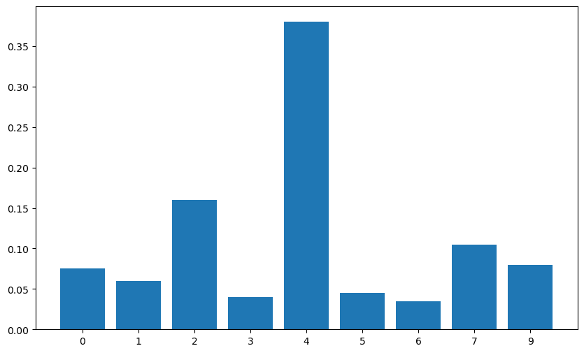
PTI VALIDATION

Slide 13
PTI VALIDATION

Slide 14
PTI CORRELATION PSEUDOCODE
for each suspect {
dataS = suspect-labeled trials
dataA = accomplice-labeled trials
dataO = other-labeled trials
bootstrapIndex = 0
for i in n_iterations {
suspectMeanSignal = take mean of n_samples of trials from dataS
accompliceMeanSignal = take mean of n_samples of trials from dataA
otherMeanSignal = take mean of n_samples of trials from dataO
SAC = double-centered correlation between suspectMeanSignal and accompliceMeanSignal
SOC = double-centered correlation between suspectMeanSignal and otherMeanSignal
if SAC > SOC
bootstrapIndex++
}
}
guess is the subject with highest bootstrapIndex

Slide 15
OUR APPROACH

Slide 16
OUR APPROACH

Slide 17
PARADIGM

Slide 18
PARADIGM

Slide 19
text

Slide 20
text

Slide 21
text

